Slide 1
Software and Software Engineering
— a presentation by Dr. K
Based on Chapter 1 of
Software Engineering: A Practitioner’s Approach (9th ed.)
by Roger Pressman and Bruce Maxim.
Notes:
Hello – This is Dr. K. Welcome to this week’s module on software and software engineering. The material covered in this module is based mostly on chapter 1 of the book Software Engineering: A Practitioner’s Approach, by Roger Pressman and Bruce Maxim.

Slide 2
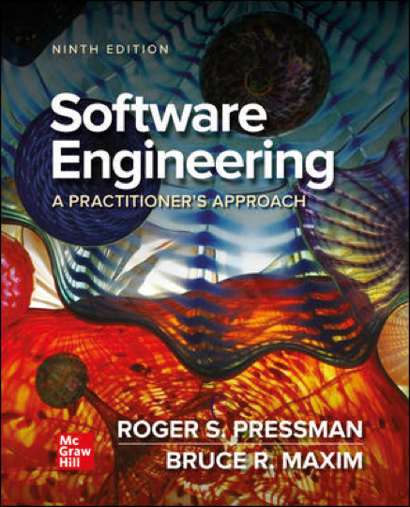
Software Engineering: A Practitioner’s Approach
Breadth over Depth
Adapting Practice
Focus on Quality
Responding to Change
Discipline vs Agility
Notes:
Before we get to the content, I want to talk a little about the textbook, and what I consider to be some of its strengths and some its weaknesses. In addition, I’ll let you know some things you should keep in mind while reading the text.
The textbook used for this course is the 9th version of the book Software Engineering: A Practitioner’s Approach by Roger Pressman. Along with Ian Sommerville’s book Software Engineering, Pressman is one of the most widely used Software Engineering textbooks around. But if you go to Amazon.com and look at the reviews of this book over the years, they don’t always seem very positive. In fact, many of them are downright negative.
[space] A recurring theme in some of the reviews is that the book covers everything so broadly, that it does not have time to get into anything in detail. And as a result, you end up with a poor understanding of a lot of different things. Well, in my opinion this is an absolutely fair criticism. Pressman is focused on breadth of information rather than depth of information. But you know... Pressman is a software engineering textbook. It’s not a requirements engineering book, it’s not an agile development book, and it’s not a quality assurance book. It’s a software engineering book. And software engineering is an *incredibly* broad discipline. You are going to find the same problems in Sommerville, or in any book that claims to cover a field as big as software engineering. If you want to get the most out of Pressman, you have to read it with this limitation in mind. In this course, we’re going to pick-and-choose which portions of Pressman we cover. And when I think that Pressman is glossing too quickly over a topic that deserves more attention, I’ll give you a link to more information, or provide you with extra reading material.
[space] Sometimes it seems to me that Pressman’s choice for breadth over depth of information is not just due to the fact that software engineering is such a broad field. It may be due to the fact that Pressman believes there is no *one-size-fits-all* approach when it comes to software development. This seems to make a lot of sense — the needs of software developers will be different depending on what they are developing and the circumstances they’re in. If you have a small team of people and you want to develop a web application, maybe you should use agile development. If you are working on mission critical software, like air traffic control, then you should probably incorporate formal methods. If you are a government contractor, then you should probably familiarize yourself with the CMMI assessment model.
[space] If there is one theme in Pressman’s book that Pressman *himself* wants to emphasize, it’s that the desire for *quality software* is the foundation of software engineering. The idea here is that there is nothing stopping the lone programmer, or even a small team of somewhat disorganized programmers, from producing a piece of software. But if you want to produce *quality software* [–] with a strong design [–] that can be maintained, then you need to *engineer* your product.
[space] Yet another theme that arises throughout the book is the notion that *change* is one thing you can rely on in software development. Any software process that you use [–] needs to have a way to respond to changing requirements, changing technologies, and changing environments. This *also* means that once you release a software product, your task is not finished — because you can be sure that your software will need to change.
One final theme I will mention here is that of a *disciplined approach* to software development vs an *agile approach* to software development. Really this theme is a kind of merger of the previous two: quality and change. Software engineers want a disciplined approach to software development because they want to be able to build a quality product. But they also want an agile approach that allows them to respond effectively to change.

Slide 3
Adapting Software Engineering Techniques
We need to produce a high-quality product, and the only way we can accomplish that in a repeatable fashion is to adapt our own subset of software engineering techniques.
— Young Developer
Notes:
Right at the beginning of the first chapter, Pressman presents an interview he did with a software developer from a gaming company. At one point in the interview the developer tells Pressman that they use some of the techniques talked about in his book, and Pressman is surprised. The developer goes on to make the point that you have to *adapt* software engineering techniques for your own purpose in order to produce high-quality software. This drives home two of the points that we talked about in the previous slide. The first is the notion of adapting software engineering techniques to fit your own needs. And the second is the notion that software engineering is necessary if you want to develop high-quality software.
We will talk more about the themes of building quality software, adapting to change, and adapting processes to fit your needs as we go through the book, but try to keep them in the back of your mind while you are reading Pressman — I think you will get a lot more out of the book that way. In the next section, we’ll start to talk about what software is [–] and how it might be different from other products we use and create.

Slide 4
The Nature of Software
Notes:
So now you have some tips on reading Pressman, like remembering the themes of Quality, Change, and Adapting Processes. In this section, we’re going to spend some time talking about the nature of software, and how engineering software is different from engineering a piece of hardware.

Slide 5
Questions Asked by Software Engineers
Why does it take so long?
Why are costs so high?
Why can’t we find errors earlier?
Why is maintenance so hard?
Why is measuring progress so hard?
Notes:
Pressman motivates this section with common questions that software engineers ask themselves about how they develop software.
[next][next] I think the first two questions here common to *all* engineering disciplines (not just software). Why does it *take* so long, and why does it *cost* so much. In some sense, these are estimation problems. How much time and money a project will need are always difficult to predict in advance. It’s true for building bridges, and it’s true for building operating systems. But software does come with its own set of unique problems in this regard, which we’ll talk about soon.
[next] Finding errors early [–] is particularly important in software development, because a *single* error that is introduced early in the software process [–] has a cruel tendency to lead to *multiple* problems later on, and, as a result, the software becomes much, much harder to fix.
[next] Maintenance is an important area of software development simply because so much time is spent in maintaining software. On average, maintenance accounts for 60% of time involved in building a piece of software. One reason that number is so large is that maintenance does not just involve fixing bugs or updating the software to work with the latest operating system. It also involves adding new features that users are requesting. In fact, one of Pressman’s favorite themes — the fact that software has to respond to change — is what makes maintenance such an important issue.
[next] Finally, how do we measure progress when we’re building a software application? One answer might be that be that we measure it based on the functionality that we deliver to the customer. But what if we want to make sure we’re doing quality work between deliveries? To answer these questions it helps to understand the nature of software and how it differs from hardware.

Slide 6
Software’s Dual Role
Software is a Product | Software is a Vehicle for Delivering a Product
Transforms information Delivers computing potential of hardware and networks | Controls other programs Effects communications Helps build other software
Produces, Manages, Acquires, Modifies, Displays, Transmits
Notes:
One of the things that Pressman emphasizes regarding the nature of software is that is has a dual role — it serves two different purposes. The first is its role as a product: as applications on computers and mobile devices, and as programs that control hardware and networks in embedded systems. Fundamentally, software *transforms* or *manipulates* information.
[next] Here are some ways of transforming information given by Pressman. The only thing I might add to this list would be storing information.
Secondly, software also serves as a vehicle for delivering a product: for example, as operating systems and drivers that control other programs and effect communication, and as compilers and IDE’s that help developers build other software.

Slide 7
What is Software?
Instructions
Data Structures
Documentation
Notes:
According to Pressman, software consists of instructions, data structures, and documentation. Now, I’m not going to talk about documentation. That one is somewhat debatable and we can save that for the discussion boards. But I do want to talk about the first two bullets: instructions and data structures, because I think there is something interesting here. When we say “software tells your computer what to do” I think it’s implied in that that software is a set of instructions for the computer. What people sometimes miss is that data is also part of software, and that storing and manipulating that data in meaningful ways is what makes software so effective. In the early days of computing there were machines constructed in such a way that instructions and data were stored in physically separate locations and accessed separately. This architecture — called the Harvard architecture — did not catch on. Some people believe that if it had, it would be much easier to guard against certain types of cyber attacks, where something masquerading as data turns out to be a set of instructions that is later executed by the CPU. Another interesting story in the relationship between instructions and data occurred in the 1960’s when some folks created a language that encapsulated the data with the operations that manipulated that data. Can you guess what kind of language this was? [–] The name of the language was Simula67 and it was the first example of an object-oriented language.

Slide 8
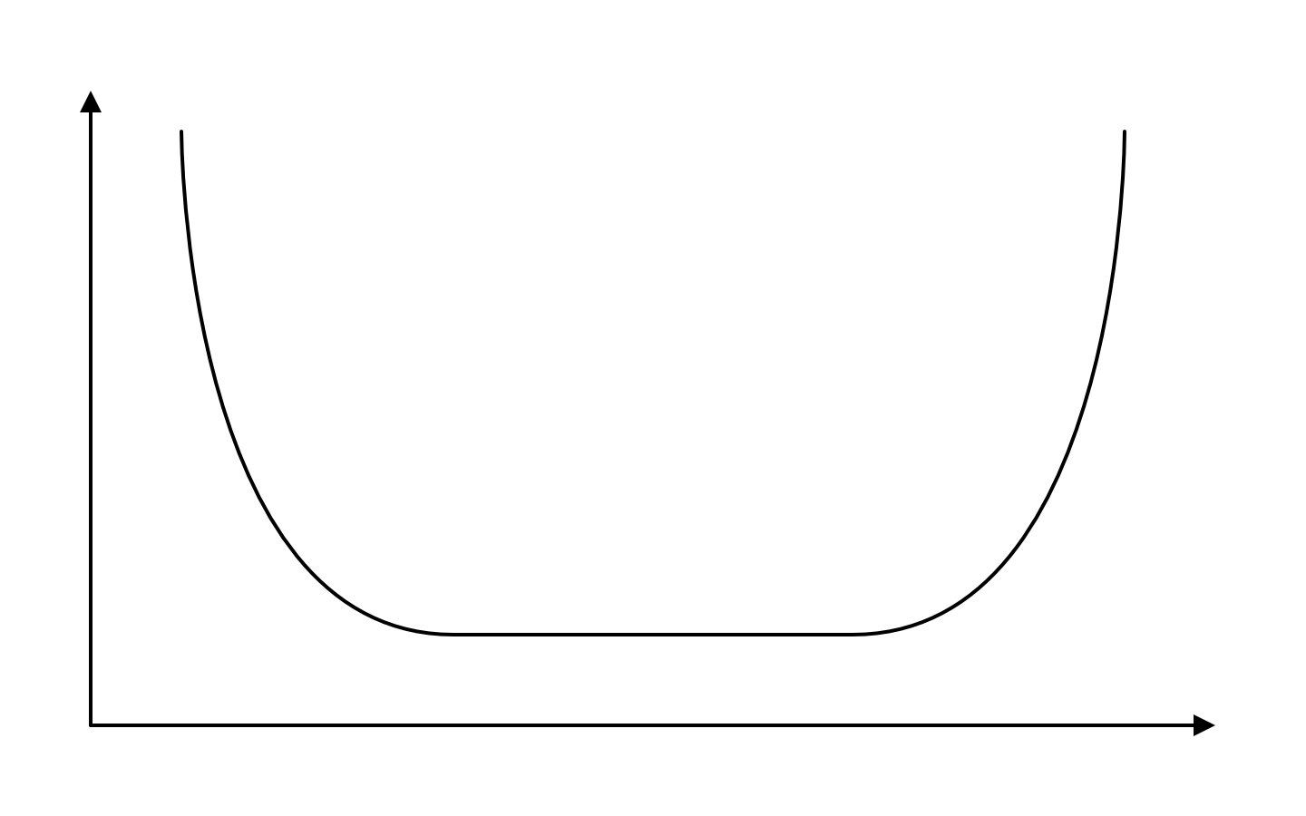
Hardware Wears Out
Failure
rate
Infant mortality
Wear out
Time
Notes:
A distinction between hardware and software that Pressman talks about in the book is the one between wear and deterioration. The vertical axis here is the failure rate. So the higher you go are on the vertical axis, the more likely your product is to fail. The horizontal axis is time. A typical failure curve for hardware looks like this, and it’s often called a bathtub curve because it looks like the cross section of an old bathtub. The high part of the curve at the beginning indicates infant mortality. This reflects defects in the manufacturing process. If there was a defect, your hardware is likely to fail relatively quickly. If it does not fail, the hardware will work for a period of time with very low risk of failure, until physical wear-and-tear take its toll, and the hardware begins to wear out, as indicated by the high part of the curve at the end.

Slide 9
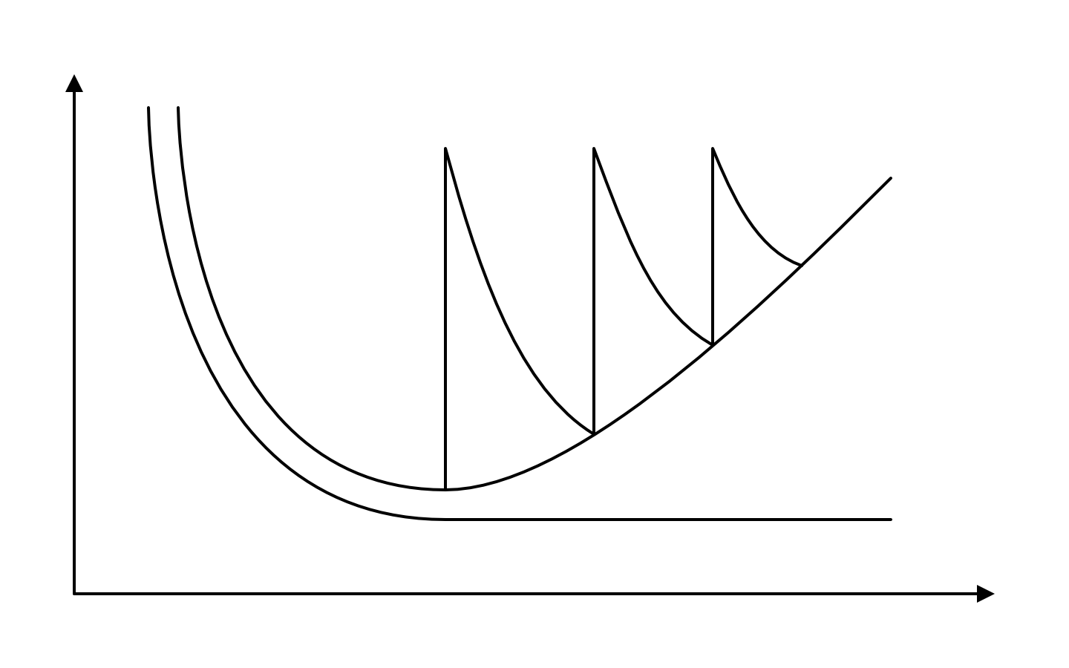
Software Deteriorates
Increased failure rate due to side effects
Failure
rate
Actual
Change
Ideal
Time
Notes:
Software is virtual, not physical, so it does not have any parts that can wear out. That means that ideally [–] a software failure curve should look like the one on the bottom. The initial infant mortality portion of the curve is due to bugs in the software, but as those bugs are discovered and fixed, the software is less likely to fail. That is the ideal case, but it is not what happens in practice. The actual failure curve of a piece of software looks like the curve on top, where the failure rate starts to rise as time goes on. And it does that because of *change*. When a significant change is introduced into the system, the software has to be modified. When the software is modified, more bugs are introduced, and it takes time to fix those bugs. Before you can fix the software so that it’s working well again, another change is introduced, and the whole cycle starts over again. When this happens, we say that the software deteriorates. When the software deteriorates so much that it is practically unusable, we start over. For example, Windows 7 was almost a complete rewrite of the original operating system because it was becoming so difficult to maintain.

Slide 10
Software Application Domains
System software
Application software
Engineering/Scientific
Embedded software
Product-line software
Web/mobile apps
Artificial Intelligence
Notes:
These are the software categories that Pressman gives in his book. Most of these should look familiar to you. As a simple exercise, please pause the video and see if you can come up with at least one example from each of these software application domains.

Slide 11
Pause and Think Application domains
System software
Application software
Engineering/Scientific
Embedded software
Product-line software
Web/mobile apps
Artificial Intelligence
Notes:
[pause 5 seconds] Ready? What did you come up with?
[next] In general, system software consists of operating systems, device drivers, and utilities.
[next] Application software consists of the applications you interact with everyday, whether on your laptop or your mobile phone.
[next] Some examples of engineering or scientific software would be AutoCAD, Mathematica, or something like SAS, which is a statistical package.
[next] Modern cars are a great example of embedded systems. They can contain up to 80 ECUs or electronic control units, which are embedded systems that control some part of the car. For example, you might have a door controller, an engine controller, a speed controller, or even a seat controller. All of these controllers have software embedded in them.
[next] Product line software is software that is produced by assembling both reusable and custom components for products that have similar systems. For example, a company with a line of televisions that have slightly different features might use product line engineering to put together the software for those TV sets.
[next] Web applications? Amazon, Google, Orbitz. Mobile applications? Take you phone out of your pocket and look at it.
[next] Finally, when I think of artificial intelligence software, I think of two things: robotics and video games.

Slide 12

Legacy Software
What do you do with a legacy system that exhibits poor quality, but is indispensable to the business?
The correct answer may be: Do nothing, at least until the system requires a significant change.
— Pressman
Notes:
One of the things that Pressman emphasizes about legacy software is that sometimes the best approach to a poor quality legacy system is to leave it alone until you are forced to change it for some significant reason. But what would a significant change look like? Go ahead and pause the video one more time and think about some of the reasons that a legacy system might have to undergo a significant change. If it makes it easier for you, just think of reasons why *any* system — not just a legacy system — might have to change.

Slide 13
Pause and Think Software change
What are some reasons that software might need to change?
Notes:
[pause 5 seconds] Ready? What did you come up with?
Well, let’s see what Pressman says about why a legacy system might need to undergo a major change.

Slide 14
Sometimes Legacy Systems Need to Evolve
Adapted to meet the needs of new technology
Enhanced to implement new requirements
Extended to work with modern systems
Re-architected to work in evolving environments
Notes:
We’ve already talked about the need to fix bugs or errors — and that *is* a kind of change, but it is not typically a change that’s going to be significant enough to make us upgrade a legacy system.
[next] A common reason that legacy software needs to change is because other hardware and/or software systems are changing around it. For example, computer and mobile hardware is being upgraded all the time. The operating systems on those devices are also being upgraded. Legacy software will need to change to work in those environments.
[next] The most common reason that *general* software (not necessarily legacy software) changes is to accommodate new features or new requirements from users. If your software does *not* continue to respond to feature request from customers, then your competition in the marketplace may gain an advantage. Sometimes this can be overdone. It can lead to feature bloat or requirements churn, and in turn, software deterioration.
[next] Sometimes software needs to be extended to work with other software systems. For example, maybe your software depends on a database for its effectiveness. If that database is updated or replaced, you will need to extend or update your software accordingly.
[next] Finally, your software may have to be re-architected to work in an evolving environment. A good example of this is if you have a piece of standalone software that needs to be re-architected to work over a network. For all these reasons, software has to change. Pressman talks about these changes specifically in the context of legacy systems, but it’s a good idea to consider how they apply to software in general.

Slide 15
Defining the Discipline
Notes:
In this section, we’re going to talk briefly about what software engineering is.

Slide 16
Definition of Software Engineering
Software Engineering is the application of a systematic, disciplined, quantifiable approach to developing, operating, and maintaining software.
— IEEE
Notes:
Here’s the IEEE definition of software engineering. The approach to software development should be systematic, disciplined, and quantifiable. The last one, *quantifiable*, says that we want to be able to measure the effectiveness of a software engineering technique. The definition also says that we should be concerned with development, operation, and maintenance. So it is not *just* about development. Obviously the software should operate correctly, but we also want to be sure we can *maintain* the software we create. And maintenance includes *changing* the software for a variety of reasons. The most common reason being... Can you remember the most common reason that software in general (not just legacy software) changes if I give you 5 seconds? [pause 5 seconds] That’s right. The most common reason that software changes is because of enhancements due to new requirements. The point here is that maintenance is a very important part of software engineering.

Slide 17
Pressman: Discipline + Agility
A “systematic, disciplined, and quantifiable” approach by one software team may be burdensome to another. We need discipline, but we also need agility.
— Pressman
Notes:
Here is Pressman’s response to the IEEE definition of software development. [–] In a previous video we talked about some of the themes in Pressman’s book. One of those themes involved balancing disciplined approaches to software engineering with agile approaches to software engineering. *Disciplined* approaches to software engineering tend to be more structured and methodical, while *agile* approaches are sometime seen as more lightweight and flexible. We’ll talk more about that distinction later, but for now just recognize that Pressman is making a case here, not only for combining discipline and agility, but also for a team being able to adapt a software engineering process to their own unique needs.

Slide 18
Layered Approach to Software Engineering
Tools
Methods
Process
Quality Focus
Notes:
This figure emphasizes that the motivation of software engineering is founded on the notion of *quality* and building a quality product. To do that, software engineers will employ some sort of process model. The details of the process may vary, but as we will see in the next section, there are general framework activities that are common to all models. Once you have chosen a model, you will adapt it to your needs, and you will use various methods to do that. For example, you have to decide which language to use, and which libraries or frameworks you will need. Finally, you will choose the particular tools you need to get the job done: IDE’s, text editors, version control systems, compilers, and so forth.

Slide 19
The Software Process
Notes:
In this section we’re going to look at the software process and some of the activities that are common to all processes.

Slide 20
The Process Framework
Communication
Requirements gathering
Planning
Estimation and scheduling
Modeling
Analysis and design
Construction
Coding and testing
Deployment
Delivery and feedback
Notes:
A typical software process has a sequence of framework activities, which can be accomplished somewhat independently of one another. Within each activity, you have tasks to accomplish and work products to create. You have milestones, and you have quality assurance checkpoints to ensure that you are on track for building a high-quality product. In addition to these framework activities, you have umbrella activities. They are called umbrella activities because they have to be carried out during every single framework activity, so they cover, or serve as an umbrella for, all the activities in the process.
The five activities that you see here are those that Pressman tells us we will find, to a greater or lesser extent, in every single process model we encounter. Not only that, but the framework activities will almost always occur in the order you see them here. Starting with communication, going through planning, modeling, and construction, and ending with deployment. Also, notice that on the right side of this diagram you have some of the important sub-activities that comprise the main framework activity. For example, communication involves both project initialization and requirements gathering. We are going to spend an entire module talking about requirements gathering. Planning is made up of estimation and scheduling, as well as tracking. Modeling has two main aspects: analyzing the requirements and creating the design for the software. We will talk about both of these in detail. That’s especially true of design. We are going to spend many modules talking about different aspects of design, like component design, interface design, and design patterns. Construction involves both coding and testing. Finally, deployment involves delivery, support, and feedback.

Slide 21

Umbrella Activities
Project tracking
Risk management
Quality assurance
Technical reviews
Measurement
Configuration management
Work product preparation
Notes:
Umbrella activities are activities that are conducted throughout the entire development process.
Throughout the complete process, we need to [next] continually track the project, [next] manage risk, and [next] ensure that we are always working in a way that will result in a quality product.
[next] We need to perform technical reviews, which are basically peer reviews of work products that you produce.
[next] And we need to measure as much of what we do as possible to ensure that we are on track. By the way, while we’re on the topic of measurement, there is one measurement in software development, and in programming specifically, that has received more praise and criticism than all other measurements combined. If I give you 5 seconds to think about it, can you say what this measurement is [pause 5 seconds] Okay. The most ubiquitous measurement in software is *lines of code* or *source* lines of code if you want to emphasize that comments are not included. The metric is criticized because it is easy to abuse so that lines of code has very little to do with delivered functionality. On the flip side, almost every other programming metric that is considered good, like function points and cyclomatic complexity, has been shown to be highly correlated with lines of code. Interesting.
[next] Configuration management. Another name for this would be change management, and if I give you 5 seconds again, what do you call the type of tool that manages changes you make to code? [pause 5 seconds] A tool that manages the changes to code is a version control system. Examples of these would be Subversion and Git. We will be using Git in our first assignment.
[next] And work product management just refers to the coordination and management of the work products produced in the project.

Slide 22
Process Adaptation
Flow of activities
Emphasis of activities
Emphasis of work products
How QA is applied
How tracking is applied
Involvement of stakeholders
Autonomy of team
Team organization
Notes:
Pressman’s philosophy on process models is that you should adapt them to your needs. Recall that Pressman’s book covers a broad range of topics rather than a few topics in detail. The book has *breadth* rather than *depth*. He is not a proponent of any one process model or software engineering technique. Rather he advocates understanding what is out there, and adapting it to fit the needs of your project. I’m not going to go through all these bullet point and describe the different ways you can adapt a software process. Most of these are self-explanatory, and you can look over them in the reading. The key point her is that, from Pressman’s perspective, and probably from the perspective of the vast majority of software developer’s, software processes are not set in stone and just like anything else, they can be adapted to fit your needs.
[–] In the next section, we will cover some general approaches to software engineering practice.

Slide 23
Software Engineering Practice
Notes:
Let’s talk a little about software engineering practice.

Slide 24
The Essence of Practice
Understand the problem (communication and analysis)
Plan a solution (modeling and design)
Carry out the plan (code generation)
Examine result for accuracy (testing and quality assurance)
— George Polya, How to Solve It
Notes:
When discussing practice, Pressman recommends a book on general problem solving by George Polya, which was written way back in 1945. And he draws a rather strong analogy – rather convincingly I think – between the problem solving steps in the book and the software development process. So, for example, there are the four broad steps, given in the book, to solving a problem: understand the problem; plan a solution; carry out the solution; and examine the result for accuracy. So, as a software engineer, I can look at these steps and it’s fairly obvious to me that they line up nicely with requirements gathering and analysis in step 1, design in step 2, construction in step 3, and verification (or testing) in step 4. But Pressman breaks this down even further.

Slide 25
Understand the Problem
Problem Solving | Software Engineering
Who has a stake in the solution? What are the unknowns? Can the problem be compartmentalized? Can the problem be represented graphically? | Who are the stakeholders? What data, functions, and features are required? Can it be broken down into smaller, easier problems? Can an analysis model be created?
Notes:
For example, under *understand the problem* Polya gives the items on the left, and Pressman maps them to the software engineering activities on the right. Namely, finding out who your stakeholders are, gathering your unknowns, seeing if your problem can be broken down into sub-problems, and finally, creating an analysis model, which is more-or-less a graphical representation of your requirements.

Slide 26
Plan the Solution
Problem Solving | Software Engineering
Have you seen similar problems before? Has a similar problem been solved? Can subproblems be defined? Can you represent the solution so it can be easily implemented? | Can you use existing design patterns or software? Are elements of the solution reusable? If so, do subproblems have solutions? Can a design model be created?
Notes:
Planning a solution is analogous to coming up with a design model. And some of the main questions here involve deciding whether you can reuse existing design patterns or software components, and whether we can break up the requirements into subsets of functionality. But the most important item is perhaps the last. As we will see, the question of whether you can create a design model for the software will always have a yes answer. However, the effort that various projects will invest in design and the various techniques they use for design is going to depend heavily on the process model that is used.

Slide 27
Carry out the Plan
Problem Solving | Software Engineering
Does the solution conform to the plan? Is each component part of the solution provably correct? | Is the source code traceable to the design model? Has the design and code been reviewed? Have correctness proofs been applied to the algorithm?
Notes:
Carrying out the plan is analogous to implementing the solution. One of the questions involved in this is whether the actual code can be traced *through* the design model all the way back to the requirements. For the second item, I might prefer to line this up with unit tests for the various component parts, rather then correctness proofs, which are rarely done for software.

Slide 28
Examine the Result
Problem Solving | Software Engineering
Is it possible to test each component part of the solution? Does the solution produce results that conform to the data, functions, and features that are required? | Has a reasonable testing strategy been implemented? Has the software been validated against all stakeholder requirements?
Notes:
Finally, validation of the software. Again, testing each component part of the solution is reminiscent of unit testing. Testing that the software overall meets the initial requirements is known as acceptance testing or validation testing.

Slide 29
General Principles
Provide value to users
Keep it simple
Maintain the vision
What you produce, others consume
Be open to the future
Plan ahead for reuse
Think before you act
— David Hooker
Notes:
David Hooker is a software engineer who came up with some basic principles that one should keep in mind when developing software. I’m not going to go over these in detail, but on the face of it they all look like reasonable and mostly common sense suggestions.

Slide 30
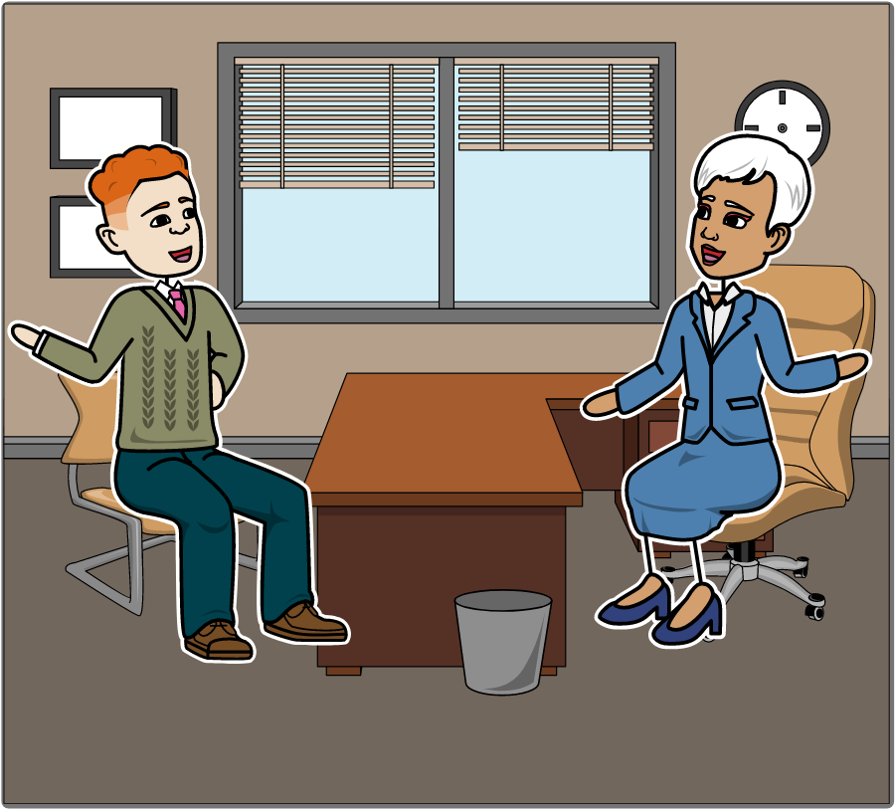
SafeHome: How It Starts [1]
We think this little wireless box will revolutionize home management!
Great idea Lee! Now what about software?
We’re going to develop a system that lets people control everything about their home from their computers...
We’ll call it SafeHome!
Notes:
Once you’ve been through a few chapters of Pressman, you’ll notice that gives you a little script somewhere in most of the chapters. It follows the evolution of a fictional software project that Pressman uses to illustrate the points from the chapter. Well, I took the liberty of making a *very* abbreviated storyboard out of this script. The dialog in these slides is extremely condensed, so I encourage you to look at the full script in Pressman. The story is a bit silly in places, but I *do* tend to find narratives more accessible than a list of bullet points, so I decided to include these in my slides.
Okay, so this is how the story begins.
The characters here are Mal, the CEO of the company that is going to create some software, and Lee, the engineering manager who came up with a little hardware device that is going to motivate the entire project.
The first scene takes place in Mal’s office. Mal is the CEO of the company and Lee is the engineering manager. Lee just showed Mal the wireless box his team came up with that will hopefully make some money for the company. Here, Lee is describing his vision of the SafeHome system that this wireless box will enable. The system will allow people to control all aspects of their home from their computers: the security system, the heating system, and so on. The point of this little exchange is that it’s a hardware device – a small wireless box – that is going to motivate the software development. And you can see here that Mal is asking Lee about the software.

Slide 31
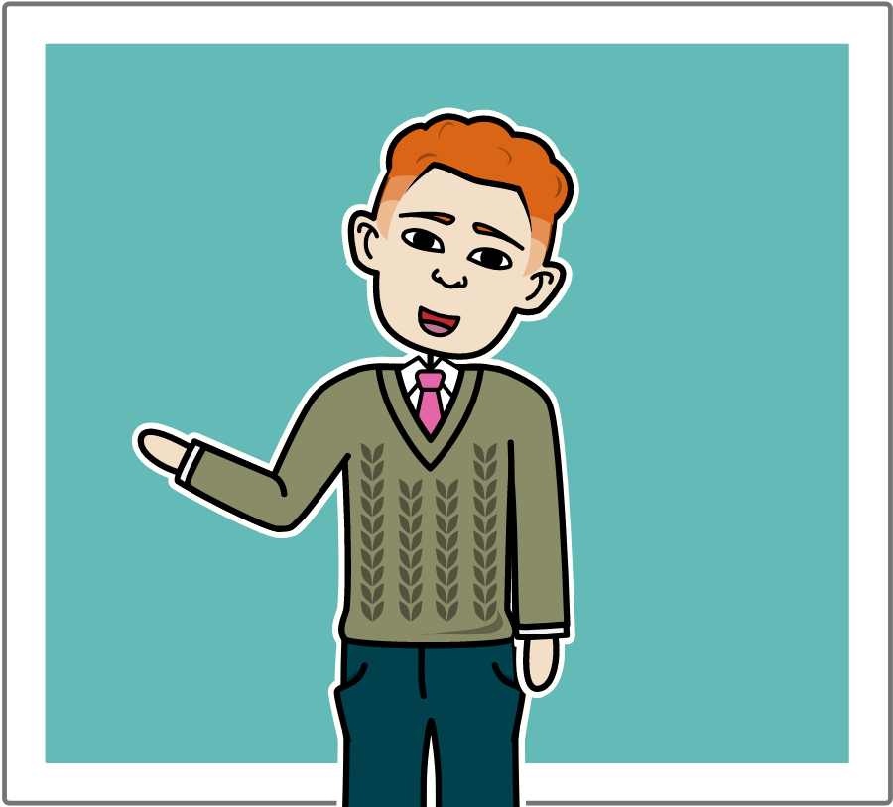
SafeHome: How It Starts [2]
Software is an issue...
But it’s nothing we can’t do.
Notes:
Keep in mind that Lee is an engineering manager; Lee is *not* a software developer, and he is not even the person who will manage the software development team. That person will be introduced later. But what Lee says here *foreshadows* the conversations that will take place in later scenes. First, he implies that developing the the software in-house *is* going to be a challenge, and second, he is confident that despite the difficulties, their software development team will be able to handle it. And that’s it, that’s the start of our SafeHome project. To be continued…

Slide 32
No Silver Bullet
Based on the essay “No Silver Bullet” from
The Mythical Man-Month (Anniversary ed.)
by Fred Brooks.
Notes:
I briefly want to talk about a couple of books that you’re going to look at in addition to Pressman. The first reading is an article called *No Silver Bullet* that can be found in a book called *The Mythical Man-Month* by Fred Brooks. Fred Brooks is a well-known software engineer, and the Mythical Man-Month is his best-known book. The Mythical Man-Month describes Brooks experiences while working at IBM in the 1960’s. He was a software project manager on one of IBM’s operating systems. He was working on a software project that was already behind schedule, and he decided to hire more programmers so that he could catch up. Unfortunately for him, instead of completing the project faster, it had the *opposite* effect of slowing everything down. This seeming paradox has come to be known as Brook’s Law. It states that adding more programmers to an already late project, will make it even later. Why in the world would that be? Take a moment to pause the video, and see if you can come up with some reasons that adding people to a late project would slow things down even more.

Slide 33
Pause and Think Adding Developers
How could adding people to an already late project make it even later?
Notes:
[pause 5 seconds]
Okay, the gist of Brooks argument here is that due to the complex nature of software, it takes a lot of time to bring new programmers up-to-speed on a project. Therefore, when you bring new programmers on, be prepared that there will be a delay in the project. [–] I’m sure there are other factors as well, and even Brook’s argument is more sophisticated than what I described. I would be interested to hear what you think about Brooks Law, and you will likely get a chance to tell me in one of the online discussions.

Slide 34
Software Complexity
I believe the hard part of building software to be the specification, design, and testing of this conceptual construct, not the labor of representing it and testing the fidelity of the representation. If this is true, building software will always be hard. There is inherently no silver bullet.
— Fred Brooks, No Silver Bullet
Notes:
Brooks Law is the subject of the Mythical Man-Month. However, you don’t have to read the book for this course. You will only need to read the essay at the end of the book entitled *No Silver Bullet*. In it, Brooks talks about the inherent complexity of software and makes the case that there will never be method or technique in software engineering that will boost productivity by an order of magnitude (for example, something that would make productivity double over a certain period of time). One motivation for this statement came from the famous *Moore’s Law*, which claimed that computing power was doubling every 2 years. This is seen by some as another distinction between hardware and software. Brooks *No Silver Bullet* has had both its supporters and critics over the years, and in the latest edition of his book, he responds to some of the critics.

Slide 35
Facts and Fallacies: People
From Chapter 1 of
Facts and Fallacies of Software Engineering
by Robert Glass
Notes:
Robert Glass’s book Facts and Fallacies of Software Engineering is a nice complement to Pressman. It’s basically a collection of over 50 observations about software engineering that Glass thinks software developers should know. As we go through certain chapters in Pressman, we will look at some of these observations.

Slide 36
Facts about People
The most important factor in software work is the quality of the programmers
The best programmers are up to 28 times better than the worst
Adding people to a late project makes it later
The working environment has a profound impact on productivity
Beware of hype. Tools and techniques account for a 5 to 35 percent increase in productivity
Learning a new tool or technique initially lowers productivity
Developers evaluate a lot of tools, buy some, and use almost none
Notes:
The first set of observations is about people. I encourage you to read these so-called facts critically, just like you should be reading Pressman. That doesn’t mean you should question everything Glass says. If he cites a study (which he does quite often) you can take that at face value, but you might also consider how he interprets the study. Some of these facts will resonate with you more than others, and in most cases cases you will get a chance to discuss them with each other online.
As an example, I will go through these 7 facts quickly and give you my first impressions of each.
[next] The most important factor in software work is the quality of the programmers. Having worked in industry for a while, that definitely rings true to me.
[next] Some programmers are up to 28 times better than others. Okay, I’m immediately wondering if the 28 times is an outlier. What’s the *average* variation in a company? And would I *want* to work in a company with such a large disparity.
[next] This one is Brooks Law, that we’ve already talked about.
[next] I definitely agree that the environment has a big effect on productivity. I would want to dig into this one a little further to see what kind of environments are considered good and what kinds are considered bad.
[next] This one is interesting to me. Because I think if I could find a tool that would increase my productivity by 20% I would buy it immediately. A twenty percent increase seem great to me, especially if everyone in the company got a 20% boost.
[next] This is what I would expect, but maybe it’s worth it if I benefit in the long run.
[next] Okay. This last one definitely ring true with my own experience. I do evaluate a lot of tools and I do end up buying some of them, often to my regret. Yeah, this one resonates.
That’s it for this series of videos on Module 1 of Software Engineering. I’ll see you in Module 2.

Slide 37
Slide with Code
public class Project {
private long projectId;
private int number;
private String name;
private boolean isActive;
public Project(long projectId, int number, String name, boolean isActive) {
this.projectId = projectId;
this.number = number;
this.name = name;
this.isActive = isActive;
}
This is a callout with an arrow attached.
Notes:
[ place text here ]

